Slide 1
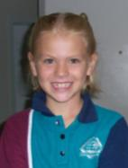
Tara’s Digital Archive Portfolio 2009
Home
English
Mathematics
HPE
The Arts
Languages
Science
SOSE
Technology
ICT
Tara is in Year 2 at CQU State School.
This portfolio contains work samples that have been selected to demonstrate Tara’s learning journey over the course of the year.
Each of the sections will be added to throughout the year with samples in the form of: text, videos, graphics, photos, and animations.

Slide 2
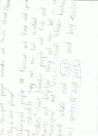
KLA: English
Home
English
Mathematics
HPE
The Arts
Languages
Science
SOSE
Technology
ICT
Work Samples Included
Speaking and Listening
Reading and Viewing
Writing and Designing
Language Elements
Literary and Non-Literary Text

Slide 3
KLA: Mathematics
Home
English
Mathematics
HPE
The Arts
Languages
Science
SOSE
Technology
ICT
Work Samples Included
Number
Algebra
Measurement
Chance and Data
Space

Slide 4
KLA: HPE
Home
English
Mathematics
HPE
The Arts
Languages
Science
SOSE
Technology
ICT
Work Samples Included
Health
Physical Activity
Personal Development

Slide 5
KLA: The Arts
Home
English
Mathematics
HPE
The Arts
Languages
Science
SOSE
Technology
ICT
Work Samples Included
Dance
Drama
Media
Music
Visual Art

Slide 6
KLA: Languages
Home
English
Mathematics
HPE
The Arts
Languages
Science
SOSE
Technology
ICT
Work Samples Included
Comprehending and Composing in
the Target Language
Intercultural Competence and Cultural Awareness

Slide 7
KLA: Science
Home
English
Mathematics
HPE
The Arts
Languages
Science
SOSE
Technology
ICT
Work Samples Included
Science as a Human Endeavour
Earth and Beyond
Energy and Change
Life and Living
Natural and Processed Materials

Slide 8
Tara Camilleri KLA: SOSE
Home
English
Mathematics
HPE
The Arts
Languages
Science
SOSE
Technology
ICT
Work Samples Included
Time, Continuity and Change
Place and Space
Culture and Identify
Political and Economic Systems

Slide 9
KLA: Technology
Home
English
Mathematics
HPE
The Arts
Languages
Science
SOSE
Technology
ICT
Work Samples Included
Technology as a Human Endeavour
Information, Materials and Systems

Slide 10
KLA: ICT
Home
English
Mathematics
HPE
The Arts
Languages
Science
SOSE
Technology
ICT
Work Samples Included
Inquiring With ICTs
Creating With ICTs
Communicating With ICTs
Ethics, Issues and ICTs
Operating ICTs

Slide 11
Speaking and Listening Sample 3/3/09

Slide 12
Reading and Viewing Sample 27/3/09

Slide 13
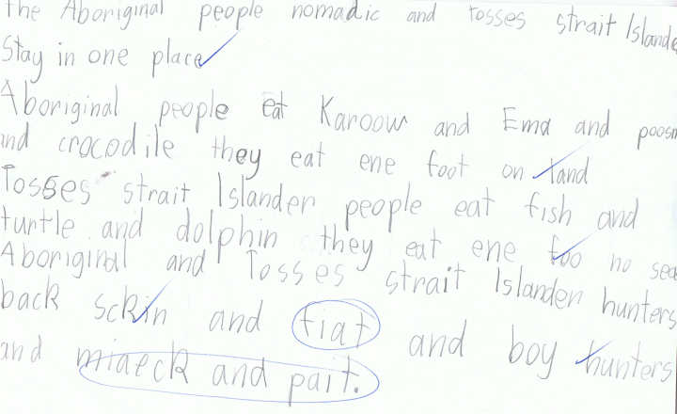
Writing and Designing Sample 4/7/09

Slide 14
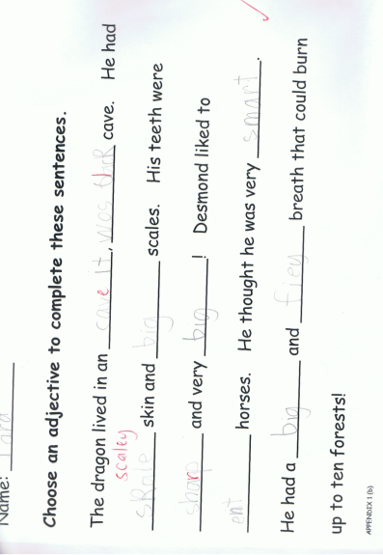
Language Elements Sample 22/4/09

Slide 15
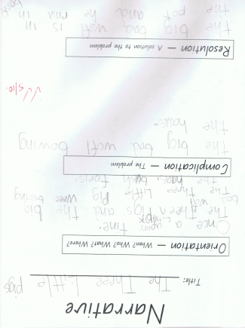
Literary and Non-Literary Text Sample 5/10/09

Slide 16
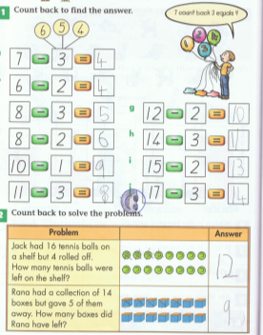
Number Sample 4/10/09

Slide 17
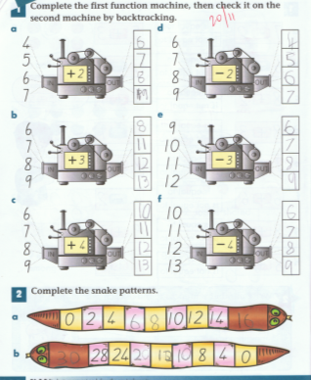
Algebra Sample 20/11/09

Slide 18
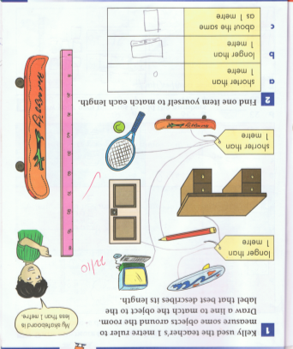
Measurement Sample 28/10/09

Slide 19
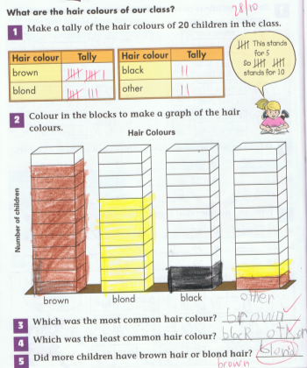
Chance and Data Sample 28/10/09

Slide 20
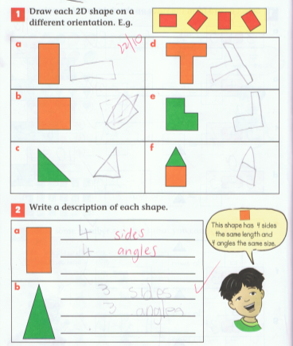
Space Sample 22/10/09

