Slide 1
Tara’s Digital Capabilities Portfolio 2009
Scientific Experiments
My Portfolio will show how I did a scientific experiment with plants.
I wanted to see what I plant needs to grow.
Home
Task Overview
Criteria Sheet
Predictions
Experiment
Observations
What I learned

Slide 2
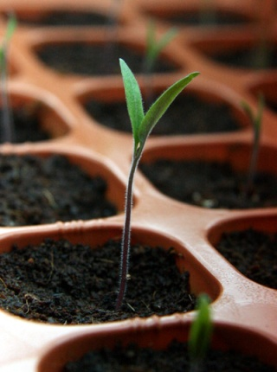
The Task Overview
Home
Task Overview
Criteria Sheet
Predictions
Experiment
Observations
What I learned
I will do an experiment with a bean seed to see what it needs to grow

Slide 3
The Criteria Sheet
For my Scientific Report
Home
Task Overview
Criteria Sheet
Predictions
Experiment
Observations
What I learned

Slide 4
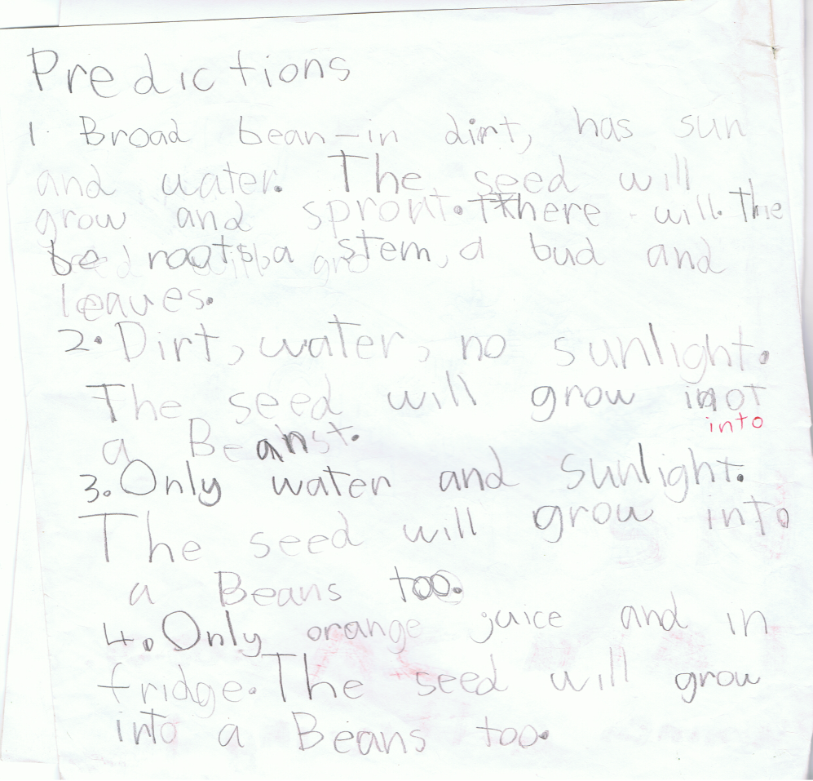
My Predictions
Home
Task Overview
Criteria Sheet
Predictions
Experiment
Observations
What I learned

Slide 5
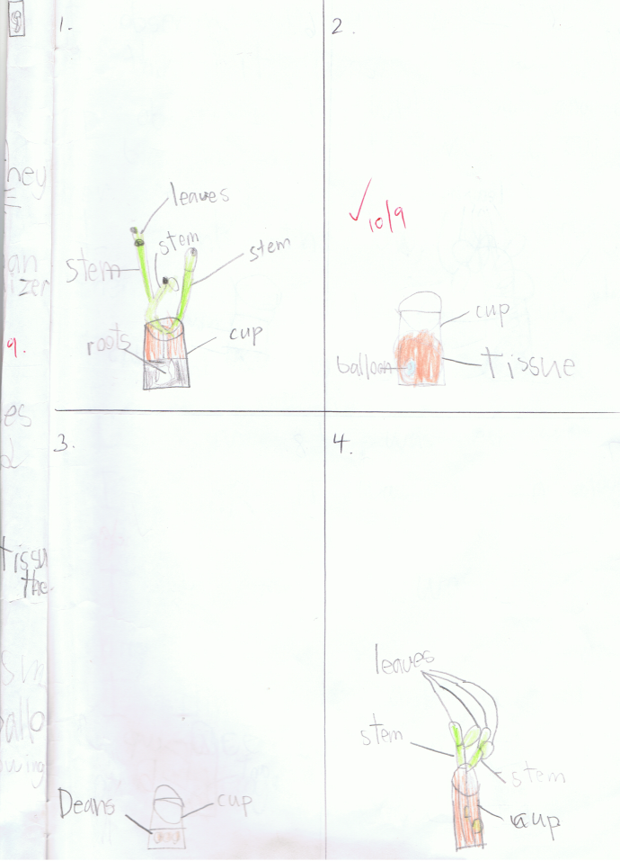
My Experiment
Home
Task Overview
Criteria Sheet
Predictions
Experiment
Observations
What I learned

Slide 6
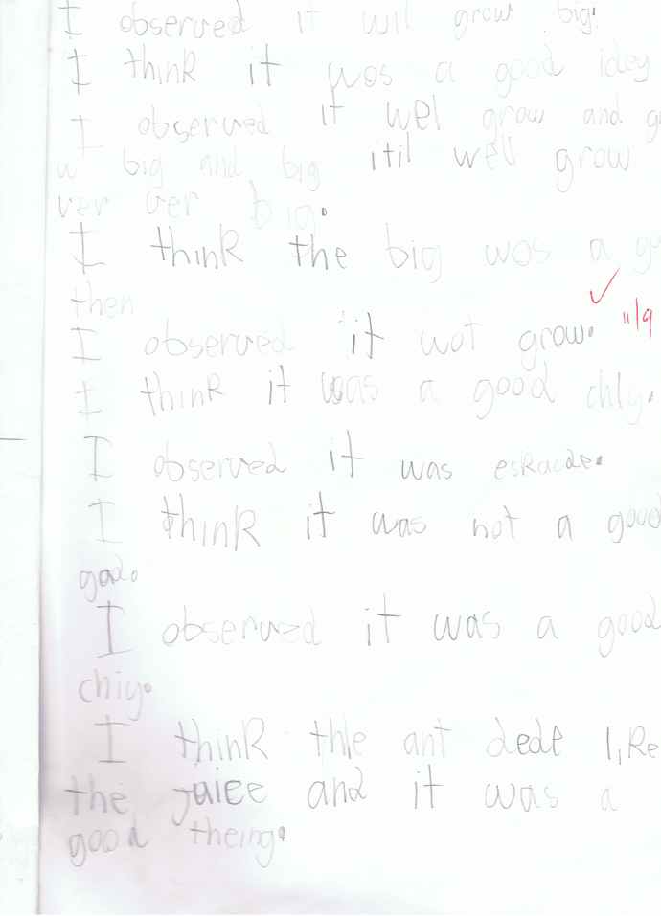
My Observations
Home
Task Overview
Criteria Sheet
Predictions
Experiment
Observations
What I learned

Slide 7
What I Have Learned
That plants need soil, water and sun shine to grow.
I learned that as the seed grew into a plant it grew lots of roots.
The leaves and the plant grew bigger and taller everyday.
Home
Task Overview
Criteria Sheet
Predictions
Experiment
Observations
What I learned

