Slide 1
Tara’s Digital Learning Portfolio 2009
Home
My Learning Goals
My Strengths
My Improvements
My Learnings
My Reflections
Tara is in Year 2 at CQU State School.
This portfolio contains content knowledge and reflections on fairytales.
Each of the sections will be added to throughout the year with samples in the form of: text, videos, graphics, photos, and animations.

Slide 2
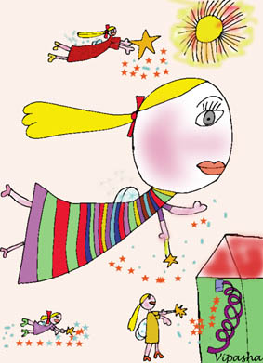
Tara’s Learning Goals 2009
Home
My Learning Goals
My Strengths
My Improvements
My Learnings
My Reflections
I need to learn about what is in a fairytale
I want to learn a new fairytale
I want to know about once upon a time
I want to make my own fairytale
I want to make a new ending to a fairytale

Slide 3
Tara’s Learning Strengths 2009
Home
My Learning Goals
My Strengths
My Improvements
My Learnings
My Reflections
I am good at looking at different fairytale characters
I am good at starting my stories with once upon a time
I am good at remembering start, middle and end of the fairy tale

Slide 4
Tara’s Learning Improvements 2009
Home
My Learning Goals
My Strengths
My Improvements
My Learnings
My Reflections
I need to remember to have a happy ending
I need to remember there needs to be a problem
I need to remember to have a title for my fairytale

Slide 5
Tara’s Learnings 2009
Home
My Learning Goals
My Strengths
My Improvements
My Learnings
My Reflections
I learned about different fairytales
I learned about how to write a fairytale
I learned how to start writing fairytales
I learned that there needs to be an evil person

Slide 6
Tara’s Learning Reflections 2009
Home
My Learning Goals
My Strengths
My Improvements
My Learnings
My Reflections
I need to remember not to forget a happy ending
I loved learning about different characters
I loved the Three Little Pigs
I don’t like the wolf in Little Red Riding Hood

Slide 7
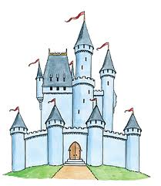
Tara’s Strengths 2009
I am good at looking at different fairytale characters because I know how to tell who is a bad and good character. Little Red Riding Hood is a good person but the Big Bad Wolf is scary and mean because he ate the grandma.

Slide 8
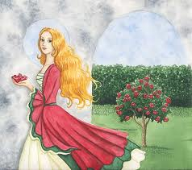
Tara’s Strengths 2009
I am good at looking at starting my stories with once upon a time. This gives me a place to start writing. Because it is upon a time I can write about anything that I want to. I know that after once upon a time, I say where the fairytale is.

Slide 9
Tara’s Strengths 2009
I am good at having a start, middle and end. The start of a fairytale talks about what is happening. The middle can have a problem. The end makes everything better.

Slide 10
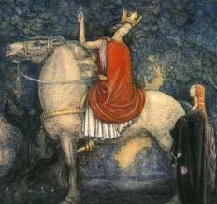
Tara’s My Improvements 2009
I need to remember to have a happy ending. I forget sometimes because I make the badie die which is not always good. I need to remember to write happily ever after.

Slide 11
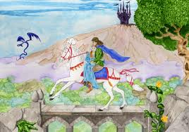
Tara’s My Improvements 2009
I need to remember to have a happy ending. I forget sometimes because I make the badie die which is not always good. I need to remember to write happily ever after.

Slide 12
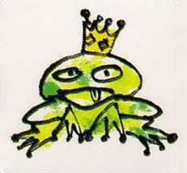
Tara’s My Improvements 2009
I need to remember to have a happy ending. I forget sometimes because I make the badie die which is not always good. I need to remember to write happily ever after.

Slide 13
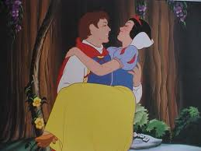
Tara’s My Improvements 2009
I need to remember there needs to be a problem. Sometimes I make my fairytales all happy so that there is a happy ending but I forget to put in a problem. I can have a bad man or a monster in to make it more scary.

Slide 14
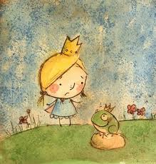
Tara’s My Improvements 2009
I need to remember to have a title for my fairytale. Sometimes I put my title as once upon a time, but I can have my title as the name of a princess in my fairytale.

Slide 15
Tara’s My Learnings 2009
I learned about lots of different fairy tales and lots of different characters. I loved Cinderella because she is a pretty princess like me. I don’t like the evil stepmother because she makes Cinderella do all of the yucky chores.

Slide 16
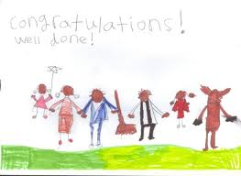
Tara’s My Learnings 2009
I learned how to write a fairytale. You need to have a title and also once upon a time. You also need to have a goodie and a badie and made up things. There needs to be a problem and also a happy ending. They can live happily ever after.

Slide 17
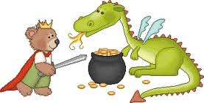
Tara’s My Learnings 2009
I learned how to start writing fairytales. You need to start with once upon a time. This lets the reader know it was upon a time and lets me know I am writing or reading a fairytale.

Slide 18
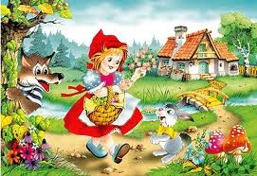
Tara’s My Learnings 2009
I learned that there needs to be an evil person. If there is not an evil person them something tricky needs to happen. If something evil does not happen, then the story can be boring.

Slide 19
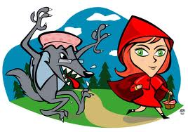
Tara’s My Learnings 2009
I learned that there needs to be an evil person. If there is not an evil person them something tricky needs to happen. If something evil does not happen, then the story can be boring.

