Slide 1
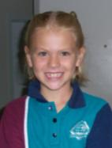
Tara’s Digital Showcase Portfolio 2009
My Fun Year
How I cared for my Learning
How I cared for Myself
How I cared for Others
How I cared for my School
My Art Gallery
Hi my name is Tara and I am in Year 2 at CQU State School.
This is my Portfolio of all my favourite things I have done this year.
I have learnt so much!

Slide 2
How I Cared for my Learning
My Fun Year
How I Cared for my Learning
How I cared for Myself
How I cared for Others
How I cared for my School
My Art Gallery
I cared for my Learning by doing my best in:
English
Mathematics
HPE
The Arts
Languages
Science
SOSE
Technology
ICT

Slide 3
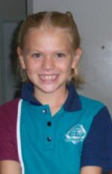
How I Cared for my Myself
My Fun Year
How I Cared for my Learning
How I cared for Myself
How I cared for Others
How I cared for my School
My Art Gallery
I cared for Myself by doing my best in:
Looking neat and tidy in my school uniform
Protecting myself from the sun
Playing safely in the school grounds

Slide 4
How I Cared for Others
My Fun Year
How I Cared for my Learning
How I cared for Myself
How I cared for Others
How I cared for my School
My Art Gallery
I cared for my Others by doing my best to:
Help others to get along together
Speak politely to others
Use the ‘Stop, Think and Do’ strategies
Play sensibly with everyone

Slide 5
How I Cared for my School
My Fun Year
How I Cared for my Learning
How I cared for my Myself
How I cared for my Others
How I cared for my School
My Art Gallery
I cared for my School by doing my best in:
Looking after the school environment
Representing the school well in the community
Wearing my school uniform

Slide 6
My Art Gallery
My Fun Year
How I Cared for my Learning
How I cared for my Myself
How I cared for my Others
How I cared for my School
My Art Gallery
My paintings and drawings
Photographs I took
Photographs of me

Slide 7
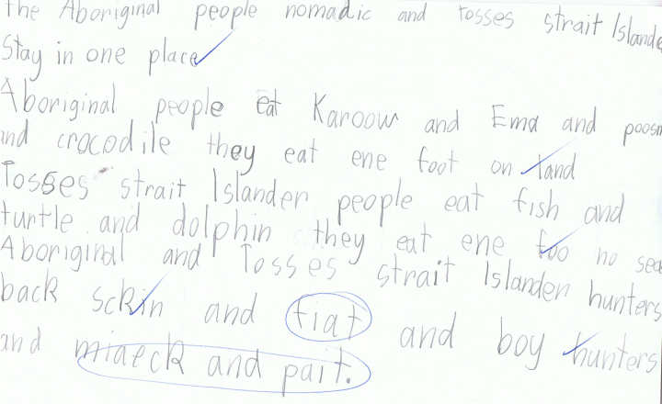
English My Favourite Story

Slide 8
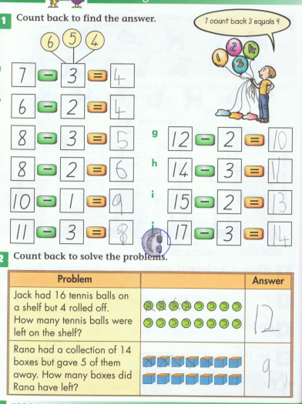
Mathmatics My Best Subtraction

Slide 9
HPE 4/7/09

Slide 10
Language 4/7/09

Slide 11
Science 4/7/09

Slide 12
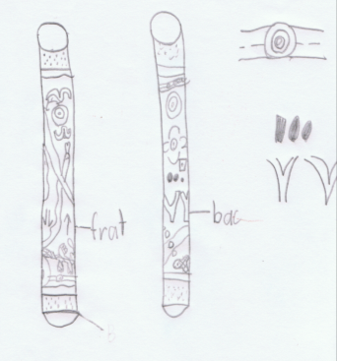
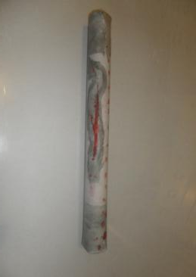
SOSE My Didgeridoo

Slide 13
Technology My Didgeridoo

Slide 14
ICT My Didgeridoo

Slide 15
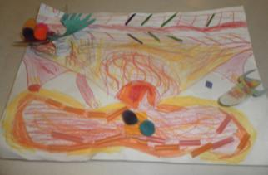
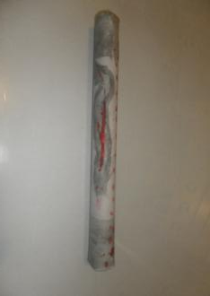
My Paintings and Drawings

Slide 16
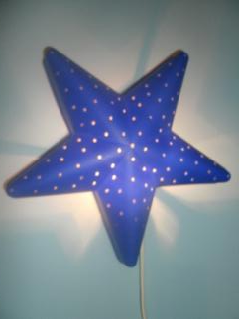
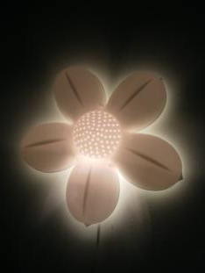
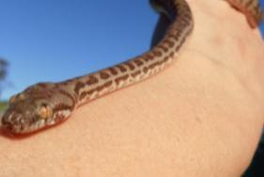
Photographs I Took

Slide 17
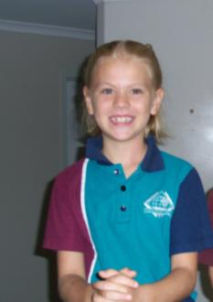
Photographs of Me

